Slide 1
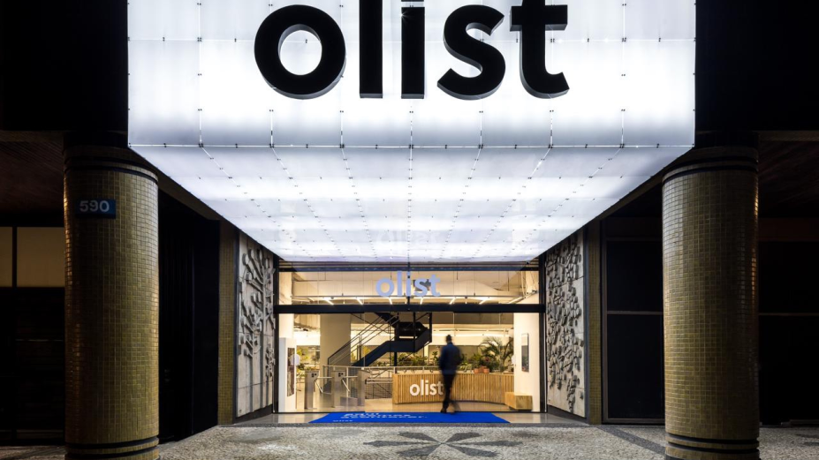
Brazilian E-Commerce Olist Store Analysis
Unlocking Key Insights into Brazilian E-Commerce Trends
Presented by Group-1

Slide 2


Meet our Team
Mr.Kiran . S
Ms.Paramjeet singh lohia
Ms.Kaviti Menaka
Mr.Ommi Sampath praneeth kumar
Ms.Kamisetty likhita bhavani
Sree Vishnu S.P.
Konni Devi

Slide 3
Introduction
E-commerce platforms generate vast amounts of data daily, and extracting meaningful insights is crucial for improving business performance. This project focuses on analyzing the performance of the Brazilian e-commerce platform, Olist Store, to provide stakeholders with actionable insights.
The primary objectives include:
Understanding customer purchasing behavior and payment trends.
Evaluating sales, profit, and review patterns to identify key performance indicators (KPIs).
Examining shipping times and their influence on customer satisfaction.
Supporting data-driven strategies to enhance operational efficiency and revenue growth.
This analysis employs tools like Excel, Power BI, Tableau, and SQL to develop interactive dashboards and reports that showcase critical insights.

Slide 4

Overview of datasets

Slide 5
KPI’s
Weekday Vs Weekend Payment Statistics
Payment Type Distribution for 5-Star Review Orders
Average Delivery Time for Pet Shop Orders
Average price and payment values from customers of sao paulo city
Relationship between shipping days Vs review scores.

Slide 6
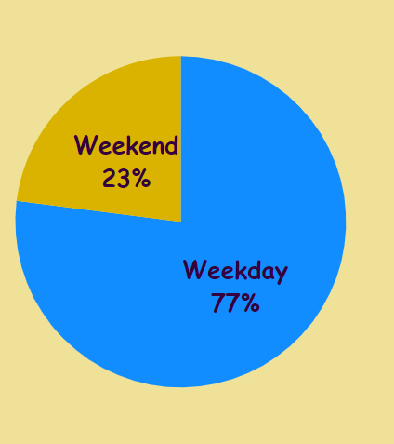
KPI 1:Weekday vs. Weekend Payment Statistics
Objective: To analyze the payment statistics based on the day of the week, identifying buying behavior patterns.
Key Insights:
77% of sales happen during weekdays, while 23% occur on weekends.
Online payment methods like credit card dominate over other methods like boleto or voucher payments.
Key Questions Answered:
Which day of the week has the highest sales?
What percentage of customers prefer online payments?
How can weekend sales be improved?
Conclusion & Recommendations:
Weekday sales are higher, suggesting a need to target weekend sales with promotions or discounts.
Explore alternative payment methods to appeal to more customers.

Slide 7
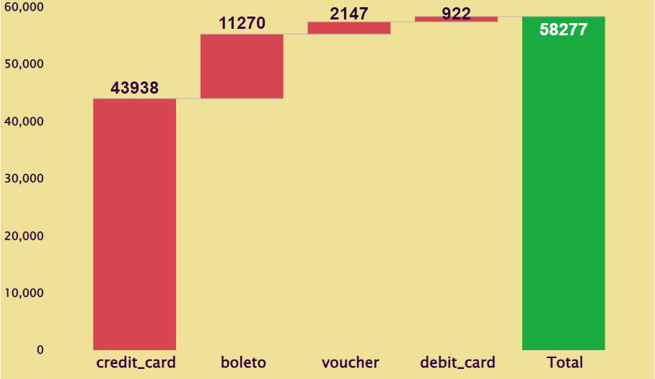
KPI 2: Payment Type Distribution for 5-Star Review Orders
Objective: To analyze the relationship between different payment methods and customer review scores.
Key Insights:
Credit card payments correlate with higher review scores.
Other payment methods, such as Debit card, boleto and voucher, show slightly lower review scores.
Key Questions Answered:
How does payment type influence customer satisfaction?
Are there any trends linking payment methods to review scores?
Conclusion & Recommendations:
Promoting credit card payment methods can result in higher customer satisfaction.
Consider optimizing the checkout process for non-credit card users to boost satisfaction.

Slide 8
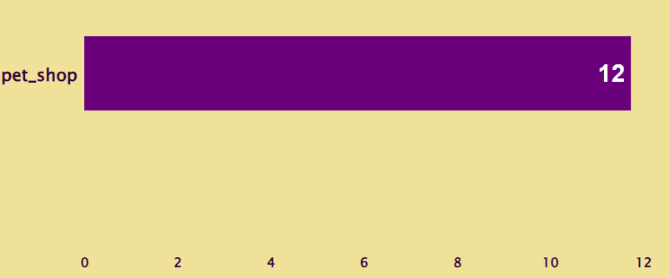
KPI 3: Average Delivery Time for Pet Shop Orders
Objective: To understand how delivery times for pet shop orders impact customer satisfaction and business performance.
Key Insights:
Average delivery time for pet shop orders is 12 days.
Pet shop orders generally take longer than other categories, affecting customer expectations.
Key Questions Answered:
How does the delivery speed for pet shop products compare to other product categories?
What impact does delivery time have on customer satisfaction?
Conclusion & Recommendations:
Reducing delivery times can improve overall satisfaction.
Focus on enhancing logistics specifically for pet shop orders to increase customer loyalty.

Slide 9
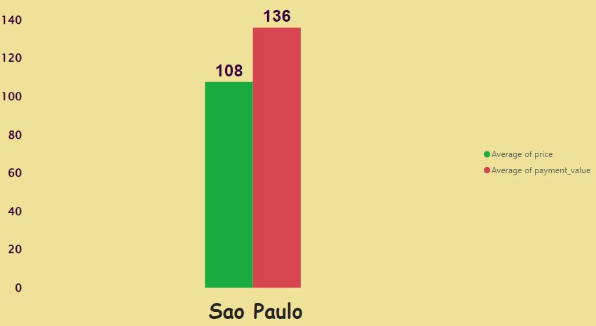
KPI 4: Average Price and Payment Values for Customers in São Paulo
Objective: To analyze the average price of products and payment values in São Paulo and identify any notable trends in customer spending behavior.
Key Insights:
Average Price in São Paulo: $108
Average Payment: $136
This indicates that customers in São Paulo are willing to pay more for certain products.
Key Questions Answered:
What is the typical spending behavior of São Paulo customers?
Are there opportunities to offer premium or higher-value products in this region?
Conclusion & Recommendations:
Upselling Opportunity: With customers spending significantly more than the average price, there's an opportunity to offer bundled products or premium options to increase transaction value.
Targeted Marketing: Focus marketing campaigns in São Paulo to capitalize on the region’s higher-than-average spending behavior.
Product Strategy: Consider introducing premium or high-margin products to maximize revenue from this region.

Slide 10
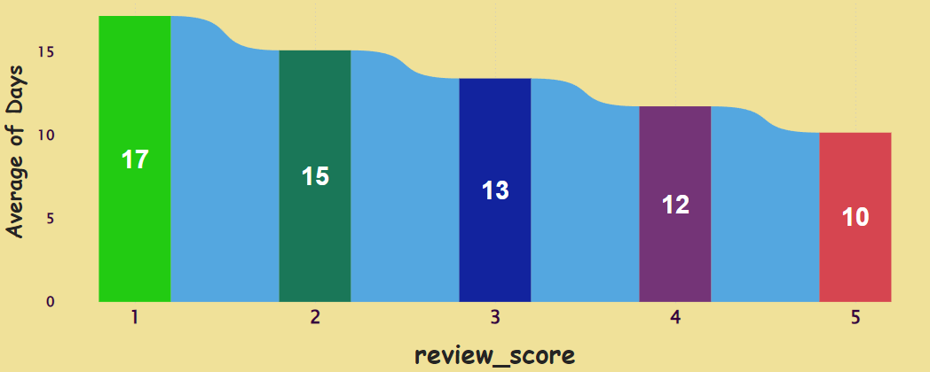
KPI 5: Delivery Speed vs. Customer Feedback
Objective: To analyze the relationship between shipping days and customer review scores to identify how delivery speed impacts customer satisfaction.
Key Insights:
Average Shipping Time: 13 days
Average Review Score: 4 stars
Customers tend to leave higher review scores when delivery is faster, indicating that shipping efficiency directly influences satisfaction.
Key Questions Answered:
How does delivery time affect customer satisfaction and reviews?
Does improving shipping speed correlate with higher review scores?
Conclusion & Recommendations:
Shipping Time Impact: Faster shipping leads to higher customer satisfaction, suggesting that reducing shipping days could improve review scores.
Actionable Strategy: Streamline logistics to reduce delivery time, which could potentially enhance the brand's reputation and increase positive customer feedback.
Focus on Operational Improvements: Identify bottlenecks in the delivery process and prioritize improving shipping speed for better customer experience.

Slide 11
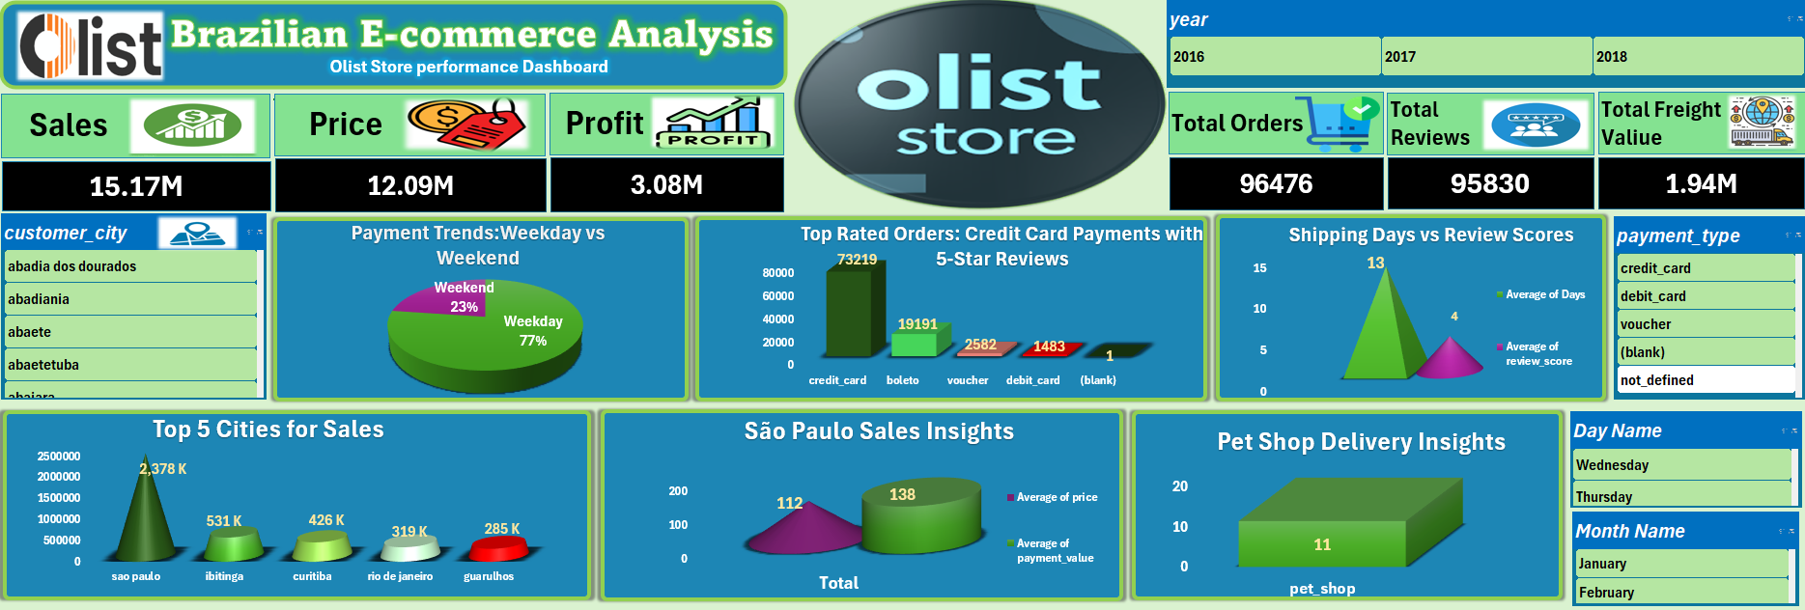
Excel Dashboard

Slide 12
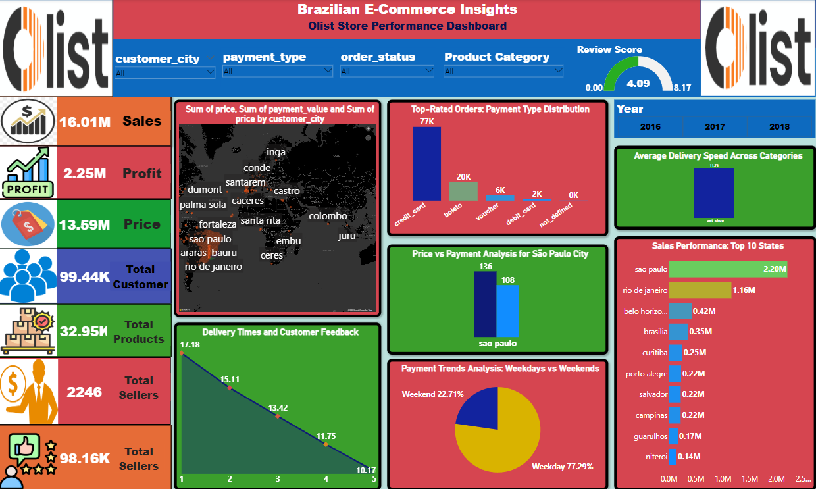
PowerBI Dashboard

Slide 13
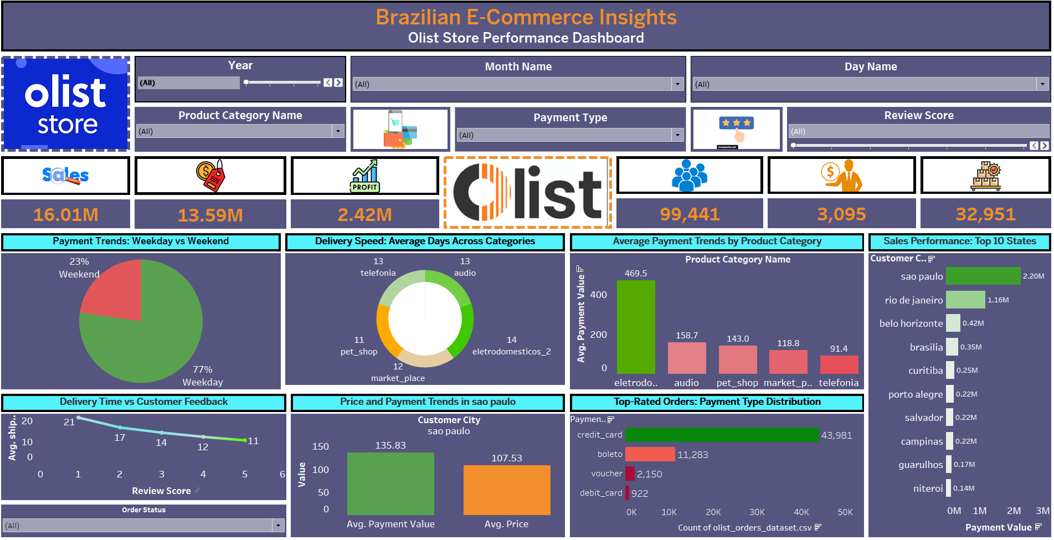
Tableau Dashboard

Slide 14
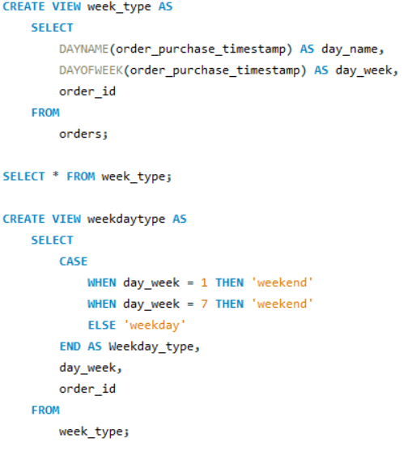
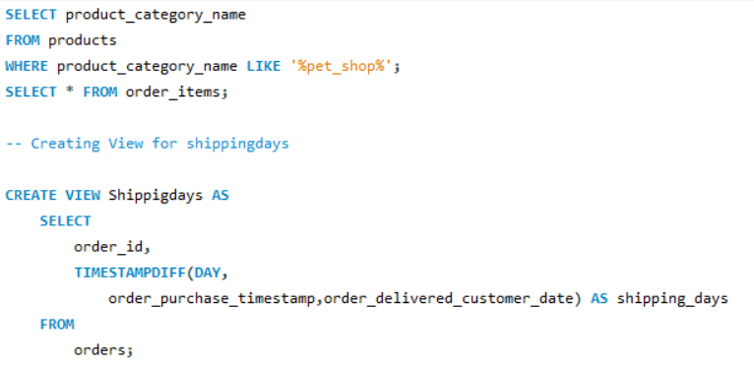
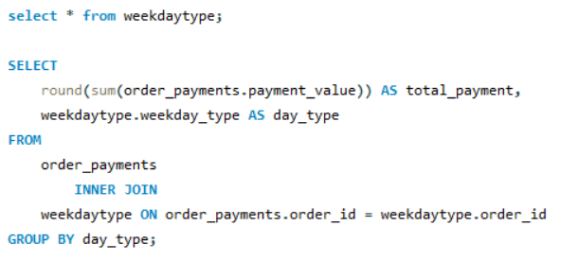
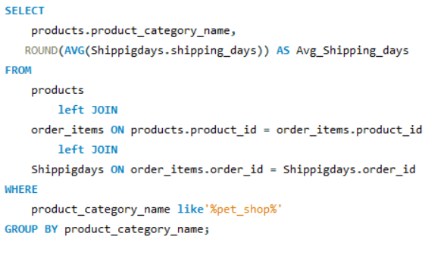
KPI 1:Weekday vs. Weekend Payment Statistics
KPI 2: Payment Type Distribution for 5-Star Review Orders
KPI 3: Average Delivery Time for Pet Shop Orders

Slide 15
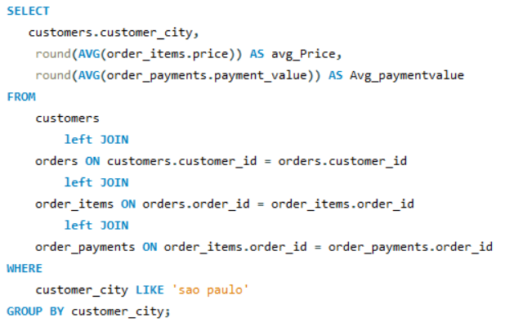
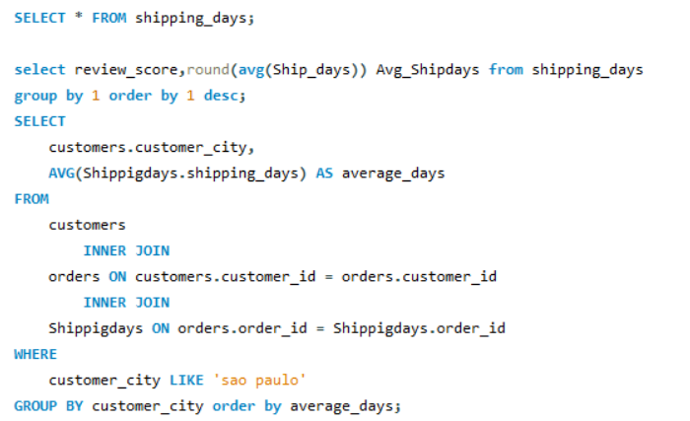
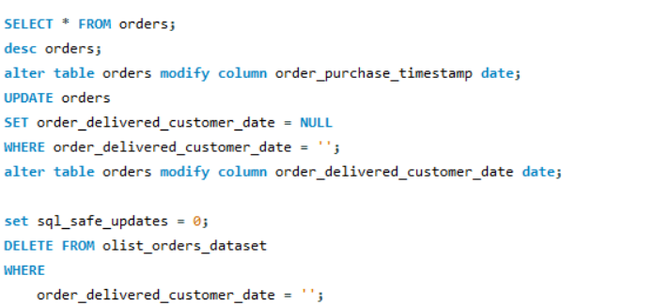
KPI 4: Average Price and Payment Values for Customers in São Paulo
KPI 5: Delivery Speed vs. Customer Feedback

Slide 16
Weekday vs Weekend Sales: We found that a majority of the sales occurred during weekdays, with weekends showing significantly lower transaction volumes. This insight allows Olist to plan weekend promotions to boost sales.
Payment Type Preferences: Credit cards emerged as the dominant payment method, with other options like boleto and vouchers being significantly less popular. This suggests a need to enhance promotion and customer awareness for alternative payment methods.
Shipping & Delivery Insights: The average shipping time for orders was around 13 days, and products in certain categories (such as pet supplies) had longer delivery times. This could affect customer satisfaction, and Olist can focus on optimizing logistics for quicker deliveries.
City-Based Trends: São Paulo was the leading city in terms of sales, with higher transaction values than other regions. Marketing efforts can be tailored to capitalize on the spending behavior of customers in São Paulo.
Customer Feedback & Delivery Speed: A relationship between delivery speed and review scores was observed, where faster delivery times contributed to higher customer satisfaction and better reviews.
Key Insights

Slide 17
Focus on
Focus on improving weekend sales with targeted campaigns and promotions.
Consider
Consider introducing more diverse payment methods to accommodate different customer preferences.
Streamline
Streamline logistics, particularly for regions with slower delivery times, to boost customer satisfaction.
Capitalize on
Capitalize on high-spending cities like São Paulo by offering premium products and bundles.
Use
Use the insights from customer feedback to enhance the delivery process and improve overall customer experience.
Conclusions &Recommendations

Slide 18

Key Learnings
Gaining insights from real-time data and visualizing them through dashboards is a powerful way to make data-driven decisions.
Understanding customer behavior through KPIs like payment methods, shipping times, and product categories can directly inform business strategies.
SQL, Excel, Power BI, and Tableau were invaluable tools in gathering, analyzing, and presenting data effectively.
This project not only provided a deep understanding of Olist’s operations but also enhanced my skills in data analysis, reporting, and business strategy formulation. The learnings from this project will be instrumental in future data analysis projects and business decision-making.

Slide 19
Thank You

